Slide 1
OPENING
CSIE for what?
  Fast and stable computing
  Smart and correct solution
MMIS "algorithms"
  materials – text, audio, images, video,…
  operations – filtering,encoding, recognition, …
Notes:
在資訊工程、在學術界、在日常生活– 的定位

Slide 2
多媒體資訊概論
平台 (WWW)
標準 (Standards)
工具 (Tools)
理論 (Theory)
Text
Audio – f: R→R, f: R→R²
Images – f: R²→R, f: R²→R³
Video – f: R→(R²→R), f: R→(R²→R³)

Slide 3
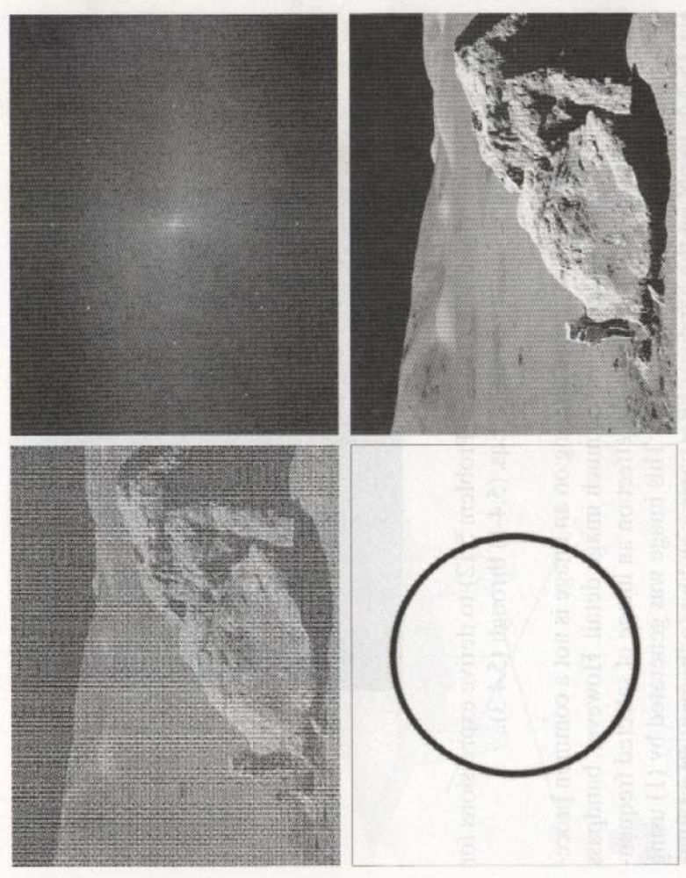
課程重點: 各種題材的本質與理論
See: Image Enhancement in Frequency Domain
f: R²→R
f(i,j)
F: R²→R
F(u,v)

Slide 4
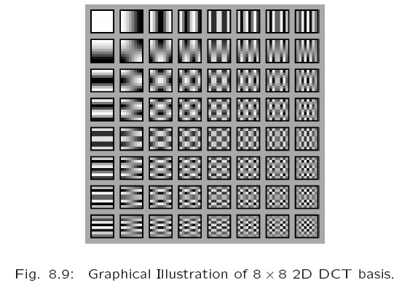
Frequency Components

Slide 5
Chapter 1
Introduction to Multimedia
Outline:
What is Multimedia?
Components of Multimedia
Multimedia and Computer Science
History of Multimedia

Slide 6
What is multimedia
When different people mention the term multimedia, they often have quite different, or even opposing, viewpoints.
  A PC vendor: a PC that has sound capability, a DVD-ROM drive, and perhaps the superiority of multimedia-enabled microprocessors that understand additional multimedia instructions.
  A consumer entertainment vendor: interactive cable TV with hundreds of digital channels available, or a cable TV-like service delivered over a high-speed Internet connection.
  A Computer Science (CS) student: applications that use multiple modalities, including text, images, drawings (graphics), animation, video, sound including speech, and interactivity.

Slide 7
Components of Multimedia
Multimedia involves multiple modalities of text, audio (music/voice), graphs (images/drawings), and movies (video/animation).
Examples of how these modalities are put to use:
  1. Video teleconferencing.
  2. Distributed lectures for higher education.
  3. Tele-medicine.
  4. Co-operative work environments.
  5. Searching in (very) large video and image databases
  6. "Augmented" reality
  7. Image based applications (diagnosis/ tracking)
  ……

Slide 8
Chapter 1
Introduction to Multimedia
Outline:
What is Multimedia?
Components of Multimedia
Multimedia and Computer Science
History of Multimedia

Slide 9
Multimedia and Computer Science:
相關技術
  HCI
  Graphics
  Visualization
  Computer vision
  Data compression
  Networking
  Database systems
  Artificial Intelligence
轉換, 編碼, 記錄, 傳輸,
增強, 修復, 變造, 合成,
保護, 偵測, 辨識, 搜尋 …
→ Algorithms

Slide 10
Examples of typical present multimedia applications
應用分類
Digital video editing and production systems.
Electronic newspapers/magazines.
World Wide Web.
Multimedia courseware.
On-line reference works, e.g. encyclopedias.
On-line games; groupware.
Home shopping.
Video conferencing.
Interactive TV.
Interactive movies.
Video-on-demand.
Hypermedia
Communication
HCI

Slide 11
History of Multimedia
1. Newspaper: perhaps the rst mass communication
medium, uses text, graphics, and images.
2. Motion pictures: conceived of in 1830's in order to ob-
serve motion too rapid for perception by the human eye.
3. Wireless radio transmission: Guglielmo Marconi, at
Pontecchio, Italy, in 1895.
4. Television: the new medium for the 20th century,
established video as a commonly available medium and
has since change the world of mass communications
5. Hypermedia: Tim Berners-Lee invented the HyperText
Markup Language (HTML), and the HyperText Transfer
Protocol (HTTP).in 1990.
6. AI involved multimedia processing:
Object Recognition, Object Detection, Object Tracking,
Generative Adversarial Network (GAN), ever since 2012.

Slide 12
多媒體資訊概論
XSL
HTML
W3C
DTD
Super Class
Define
New version
Organize
XML
XHTML
Protocol
(language)
DVD Player
MathML
Define
WWW
e.g.2
e.g.1
Irrelevant
Other
languages
SMIL
傳播平台
標準 (Standards)
Adobe SVG
storage
format
Photoshop
e.g.1
Macromedia VML
Dreamweaver
File format
e.g.2
編輯工具
理論 (Theory)
Flash MX
e.g.3

Slide 13
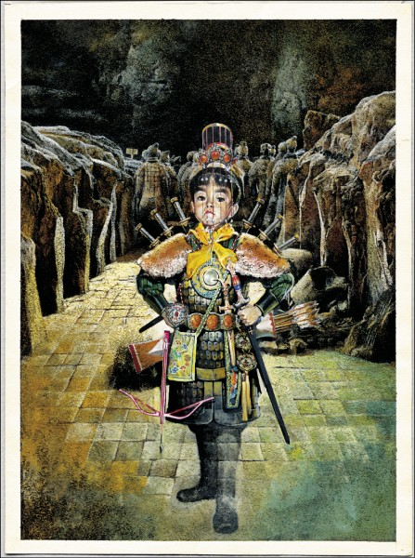
平台
標準
編輯工具
理論
創作理論
Notes:
希區考克解釋庫勒雪夫效果蒙太奇(montage)一詞源自法語，指一個物體或建築體被「組裝」起來、「建構」起來的意思。用於電影上，指的是特別具有藝術表現力的電影剪接手法，可以帶領觀眾跳脫空間與時間的限制，並向觀眾傳達更為深刻的情感或思想。

